Slide 1
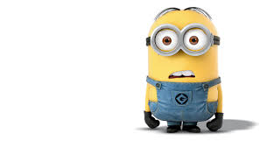
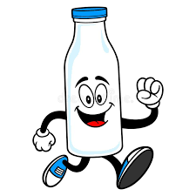
Do you like collecting glass bottles?
What’s the name of your hobby?

Slide 2
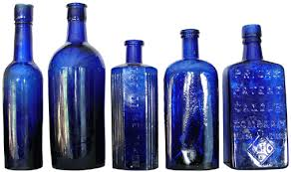
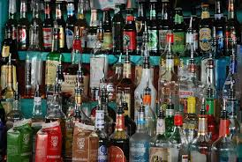

Slide 3
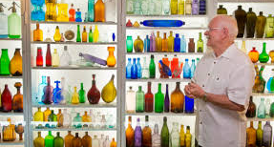
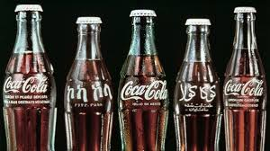

Slide 4
UNIT 1 MY HOBBIES
Period 7
Lesson 6 skills 2

Slide 5
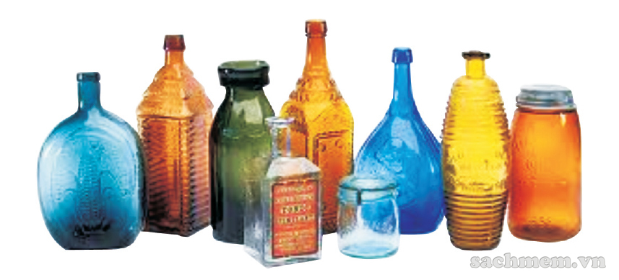
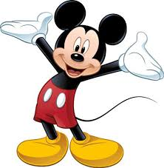
UNIT 1 MY HOBBIES
Period 7
Lesson 6 skills 2
listening
1. Do you know anything about collecting glass bottles? Do you think it is a good hobby? Why/ why not?
I think collecting glass bottles is a good hobby. Because you can collect a lot of old bottles and use for other purposes. For example, we can use it to decorate our house or make some souvenirs from them. It also contributes to saving the environment

Slide 6
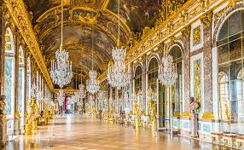
UNIT 1 MY HOBBIES
Period 7
Lesson 6 skills 2
vocabulary:
- Glass bottle(n)
: chai thủy tinh.
- decoration/dek.əˈreɪ.ʃ ^{ə}n/ (n)
: sự trang hoàng/trang trí.
- decorate/ˈdek.ə.reɪt/ (v)
: trang trí.
vases/veɪsiz/ (n)
: bình hoa.

Slide 7
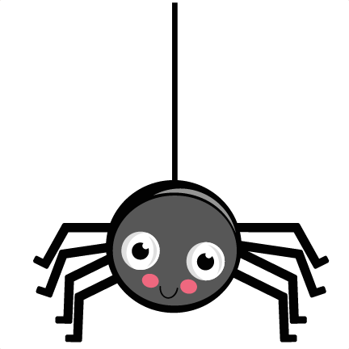
UNIT 1 MY HOBBIES
Period 7
Lesson 6 skills 2
2. Listen to an interview about hobbies. A 4!Teen reporter, Ngoc, asks Mi about her hobby. Complete each blank in the word web with no more than three words

Slide 8
Name of the hobby:
.
2. started:
.
3. Person who shares the hobby with Mi:
.
Collecting glass bottles
2 years ago
mother
Mi’s hobby
4. To do this hobby Mi has to:
a) Collect bottles after use + get them from
.
b) Make vases or .
c) Use them as ‘
decorations,
grandmother
flower
6. Future: will
.
5. Feelings about the hobby:
.
lamps
Continue the hobby
home
Useful hobby, safe enviroment

Slide 9
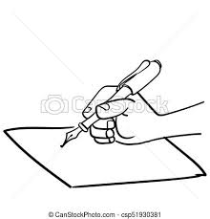
UNIT 1 MY HOBBIES
Period 7
Lesson 6 skills 2
Writing
3. Work in pairs. Ask and answer questions about each other's hobby. Take notes below

Slide 10
3. Work in pairs. Ask and answer questions about each other's hobby. Take notes below
2. When he/she started the hobby:
.
3. Who he/she shares it with:
.
Name of the hobby:
.
‘s
hobby
6. Future:
.
4.To do this hobby you have to:
.
5. Feelings about the hobby:
.

Slide 11
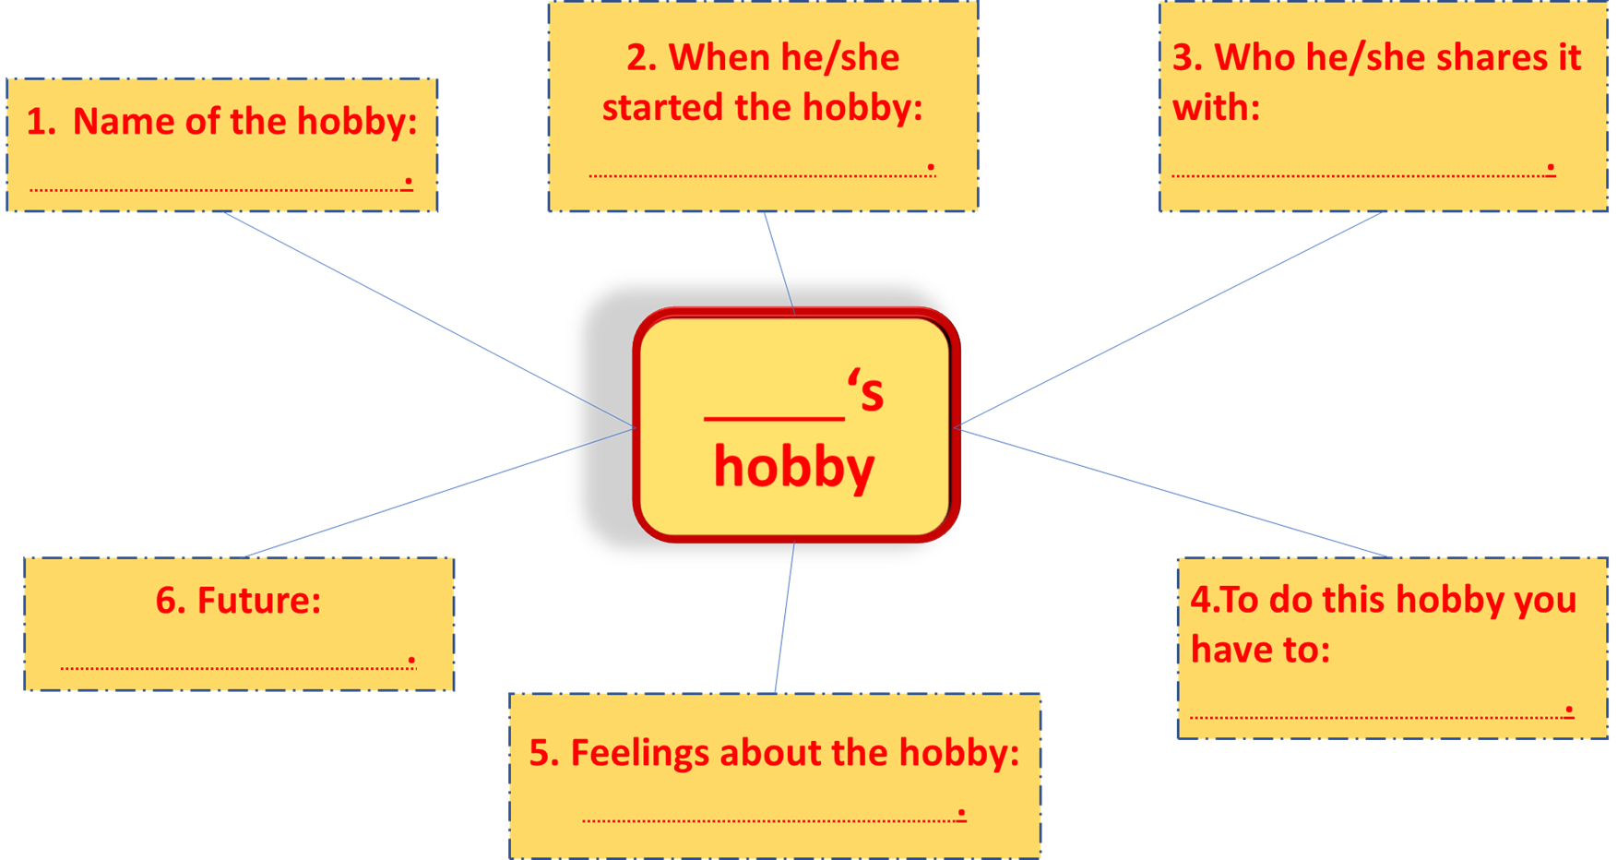
4. Now, write a paragraph about your classmate's hobby. Use the notes from 3. Start your paragraph as shown below.
is my classmate. His/her hobby is .

Slide 12
Example:
Play the guitar
Since 14 years old
Mother and father
Hoa
4. To do this hobby you have to:
Stop playing the guitar.
know the melody of the songs.,
hardly.
Comfortable, interesting

Slide 13
Example:
Hoa is my classmate. Her hobby is playing the guitar. She play the guitar since fourteen years old. She play the guitar very good she usually play guitar to her parent. My classmate said to me if I want to be her, I need to know the melody of the song. in other hand, I must study hard for this. Playing the guitar help her comfortable and give more interesting in her life. Although she love playing the guitar, she has to stop the hobby. She want to spent time for study in the school.

Slide 14
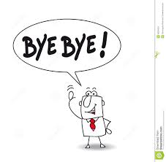
HOMEWORK
Gtammar: the present simple and the future simple.
Write a paragraph about your hobby.
Prepare for looking back p.14

